Slide 1

Project Report on Tour Management System
Harsh Mishra

Slide 2
Table of Contents:-
Introduction
System Architecture
Frontend development (Angular18)
Backend Development(Springboot)
Database Design(MySQL)
Key Features and Functionality
Testing and Quality Assurance
Challenges and Solutions
Conclusion
Appendix

Slide 3
Introduction - Overview of the Tour Management System
The system is designed to manage the various aspects of a tour operation, such as booking hotels, managing hotel accommodations, managing customer database, handling customer reviews and maintaining thr facilities of hotels
The system allows admins to manage bookings, hotels, facilities, reviews, and admin registrations.

Slide 4
Introduction - Purpose of the System
To streamline tour bookings and provide a seamless experience for administrators.
Automates the management of tours, hotels, guests, facilities, and reviews.
Aims to increase operational efficiency, reduce human errors, and improve customer satisfaction.

Slide 5

Introduction - Technologies Used
Angular 18: Used for building dynamic, single-page applications with a responsive UI.
Spring Boot: A framework for building the backend with Java, providing a robust and scalable environment for handling business logic and database operations.
MySQL: A reliable relational database to store all hotel, booking, guest,facilities and review data.
Postman: Used for API testing and debugging, ensuring the smooth functioning of communication between frontend and backend.

Slide 6
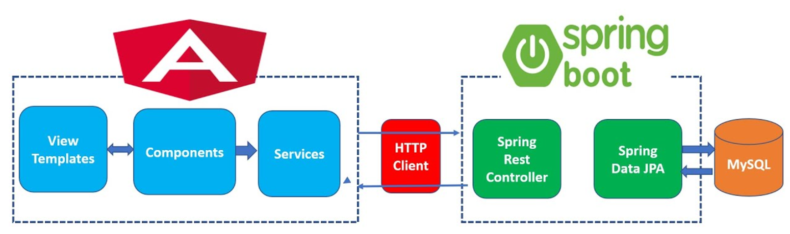
System Architecture - High-Level Architecture Overview

Slide 7
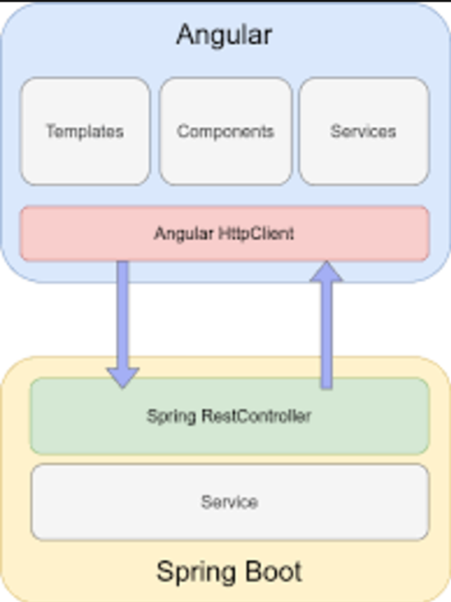
System Architecture:- Frontend (Angular 18) and Backend (SpringBoot) Interaction

Slide 8
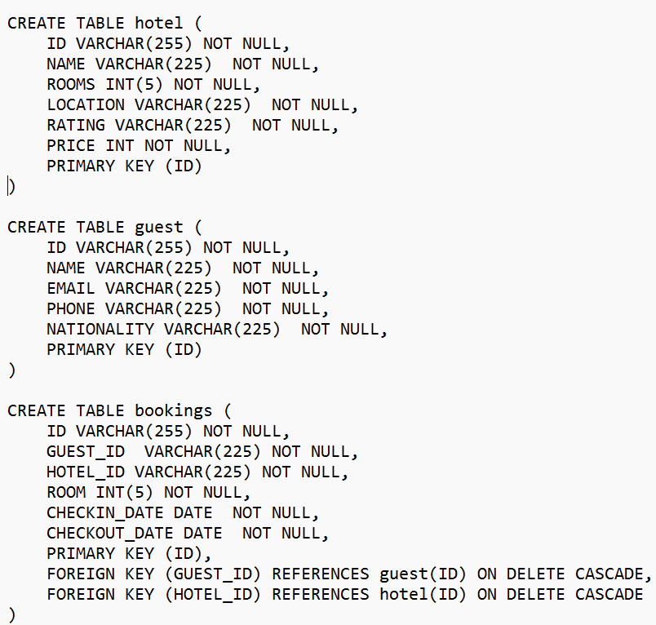
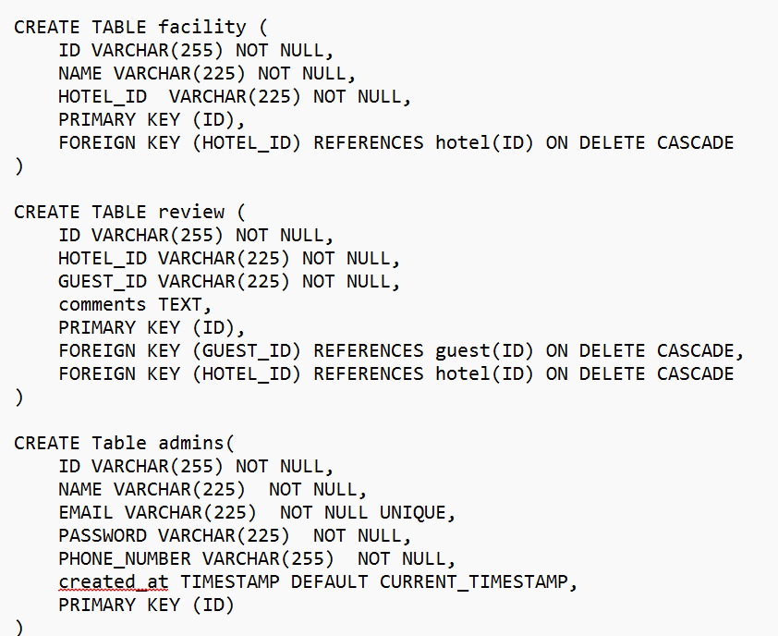
System Architecture - Database Design (MySQL Schema)

Slide 9
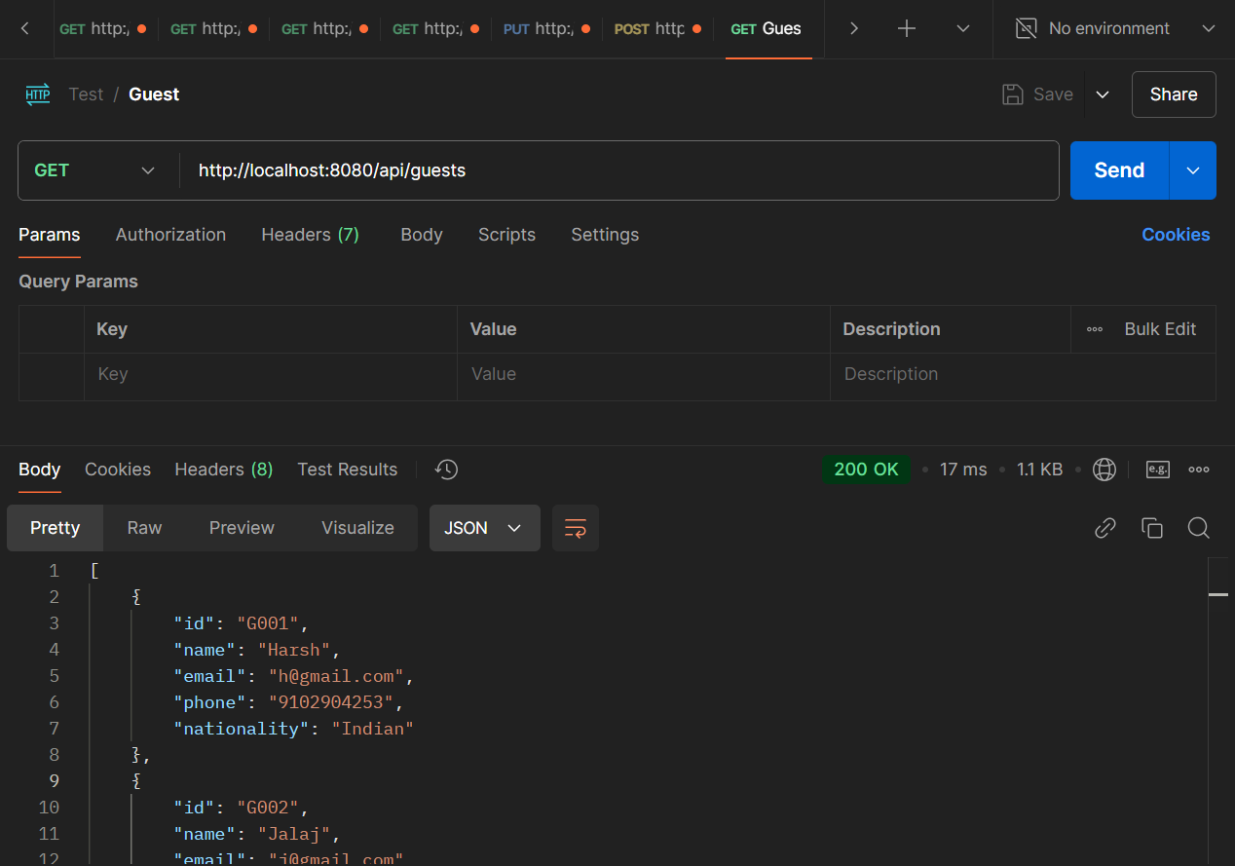
System Architecture - Integration with Postman for API Testing

Slide 10
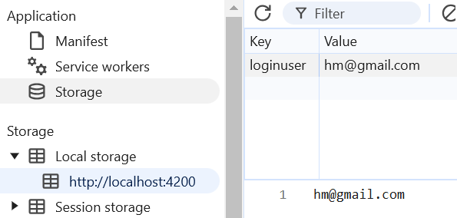
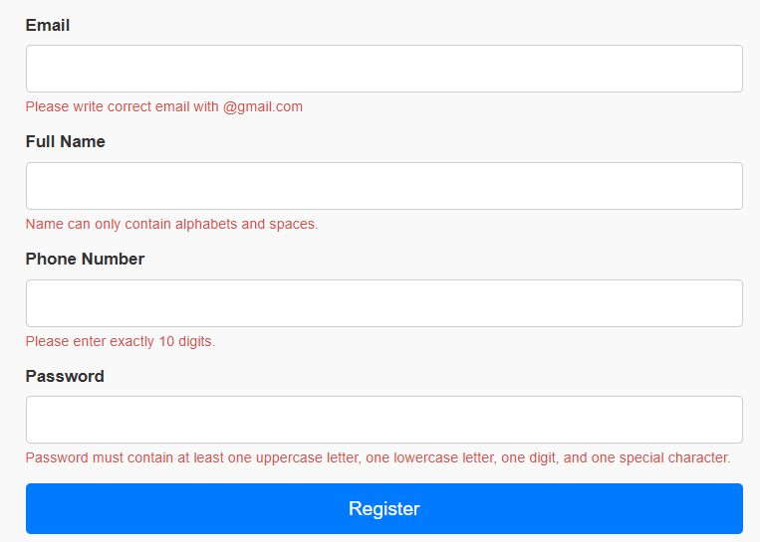
System Architecture - Security Considerations AND conditional rendering

Slide 11
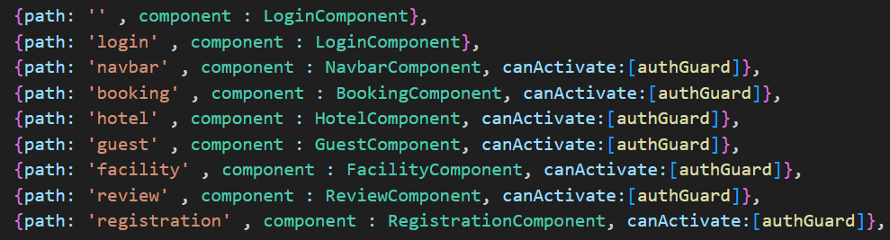
Frontend Development (Angular 18)
The Angular application is designed with a modular and component-based architecture, ensuring scalability and maintainability. Key components include LoginComponent, NavbarComponent, BookingComponent, HotelComponent, GuestComponent, FacilityComponent, and ReviewComponent. The application is protected with authGuard, ensuring secure access to sensitive areas like bookings, hotels, and guest information. Routing is optimized for seamless navigation between pages, and components are designed for dynamic content updates using two-way data binding. The application prioritizes responsiveness, delivering a smooth experience across devices, and leverages Angular's powerful features for efficient development.

Slide 12
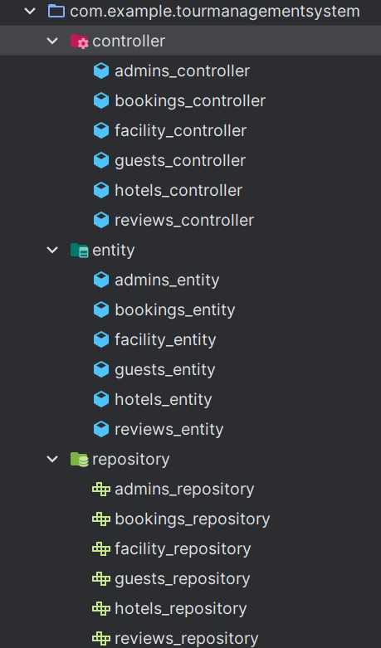
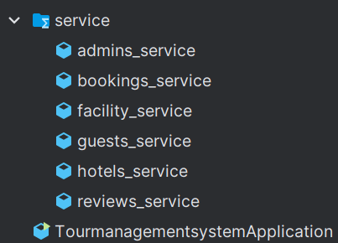
Backend Development
(Spring Boot)
The Spring Boot application follows a layered architecture with controllers, entities, repositories, and services for each module, including admin, booking, facility, guest, hotel, and review management. Controllers handle HTTP requests and map them to appropriate services, while entities represent the core business logic and map to database tables using JPA. Repositories enable efficient data access and CRUD operations via Spring Data JPA, and services encapsulate the business logic for each module, ensuring data is processed before interacting with the database. This structure promotes clean, maintainable code, optimized performance, and clear separation of concerns.

Slide 13
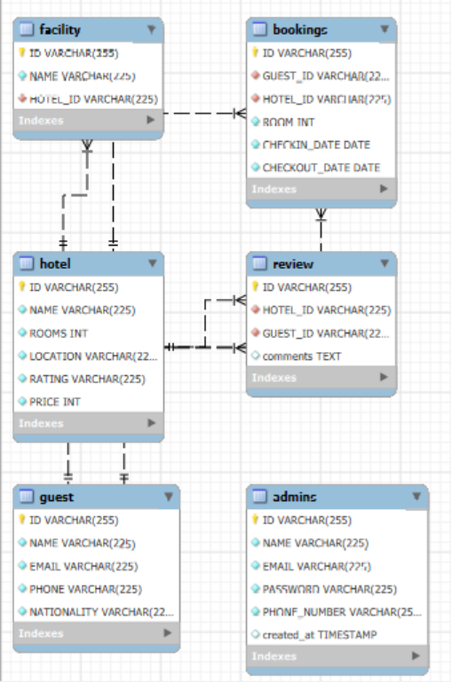
Database Design (MySQL)
The database design is structured to manage a comprehensive tour management system, with key tables for hotels, guests, bookings, facilities, reviews, and admins. Each table is linked using foreign key constraints to maintain referential integrity. The hotel table stores hotel details, while the guest table holds guest information. The bookings table links guests to hotels with check-in and check-out dates, and the facility table manages hotel amenities. Reviews are captured in the review table, allowing guests to leave feedback. The admins table tracks system administrators. Cascade delete ensures related data is removed upon deletion, preserving data consistency.

Slide 14
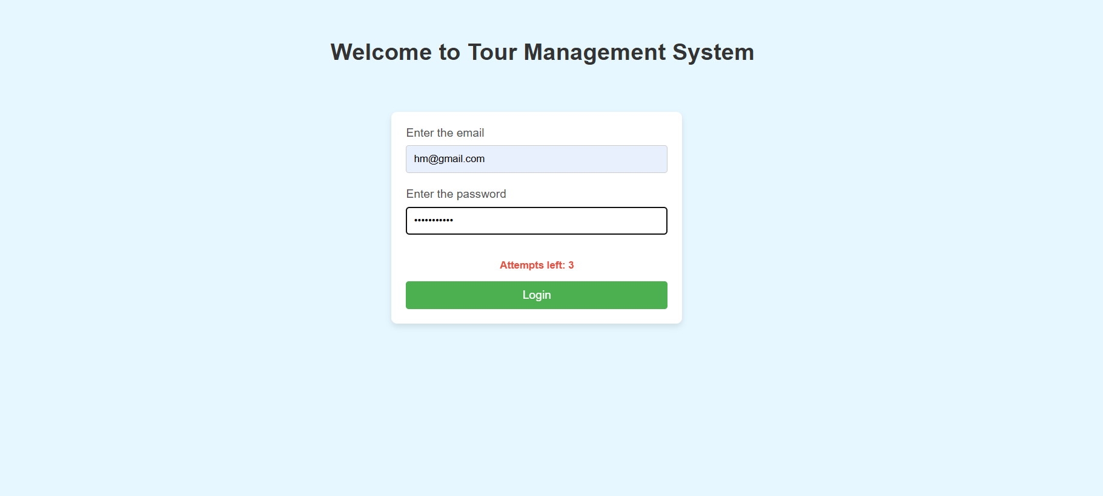
Key Features and Functionality – Login page

Slide 15
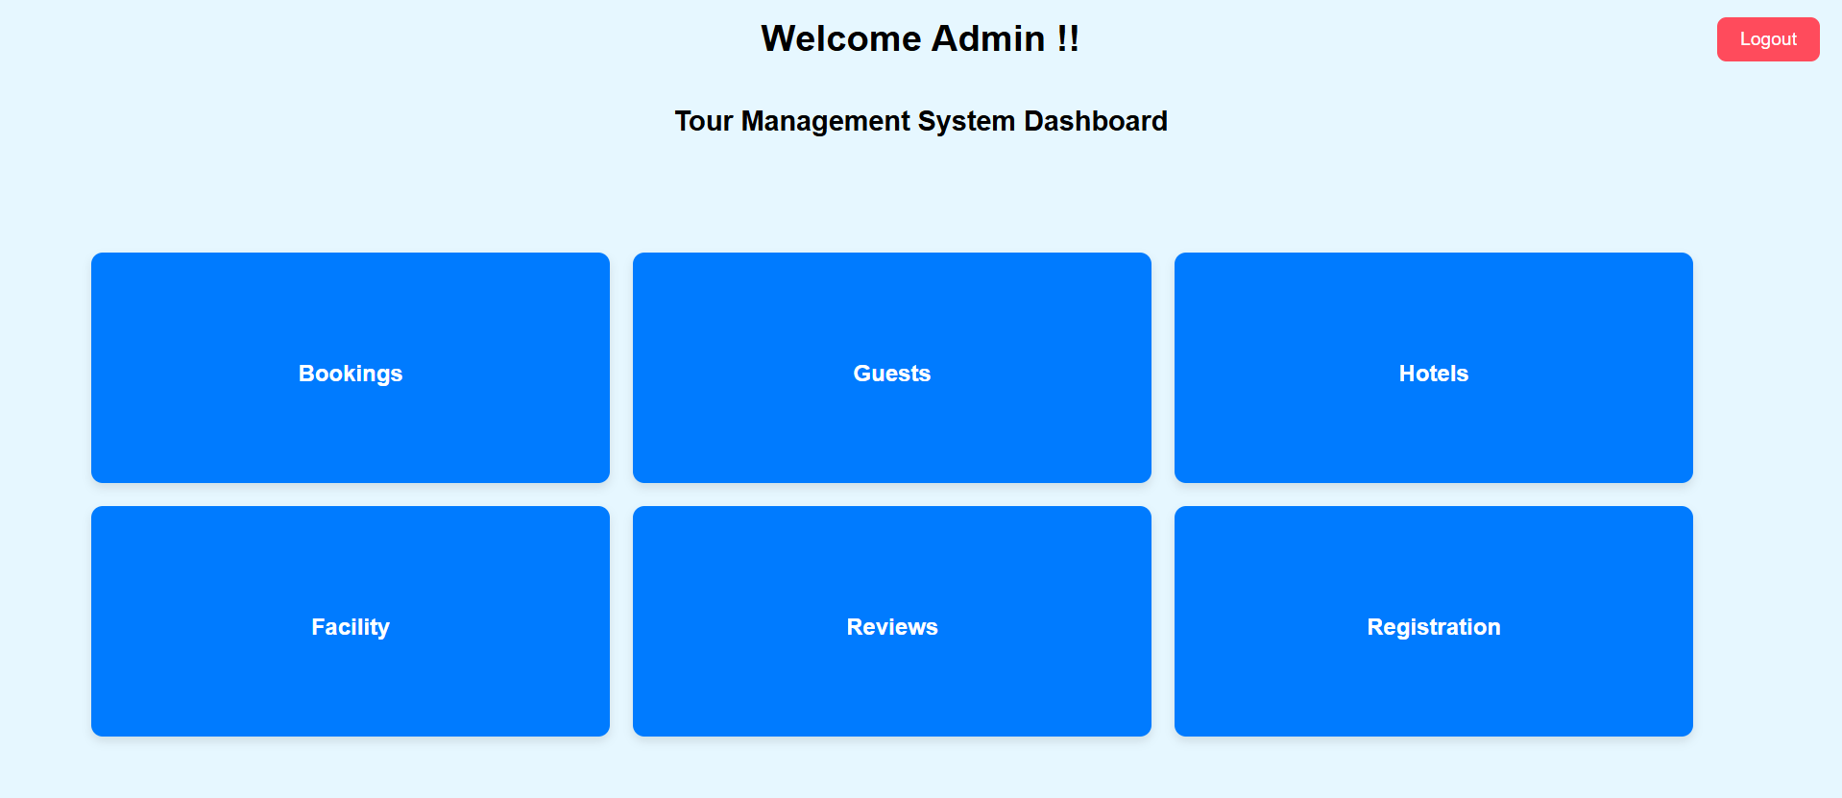
Key Features and Functionality – main DASHBOARD

Slide 16
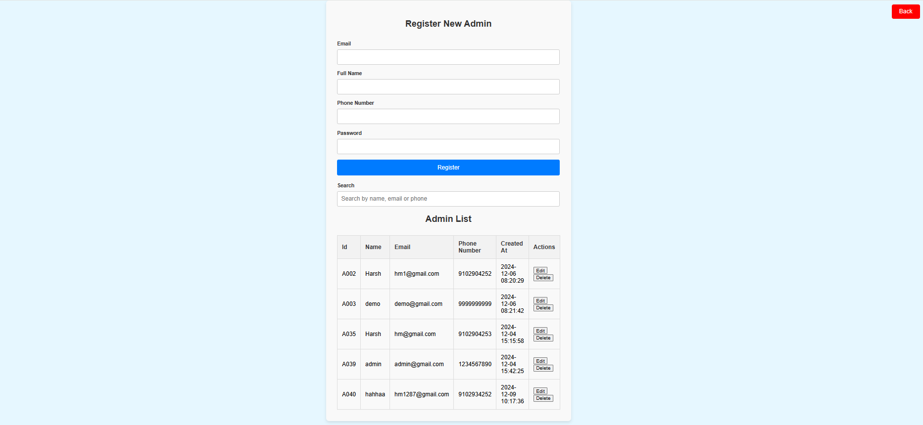
Key Features and Functionality – aDMINS DASBOARD

Slide 17
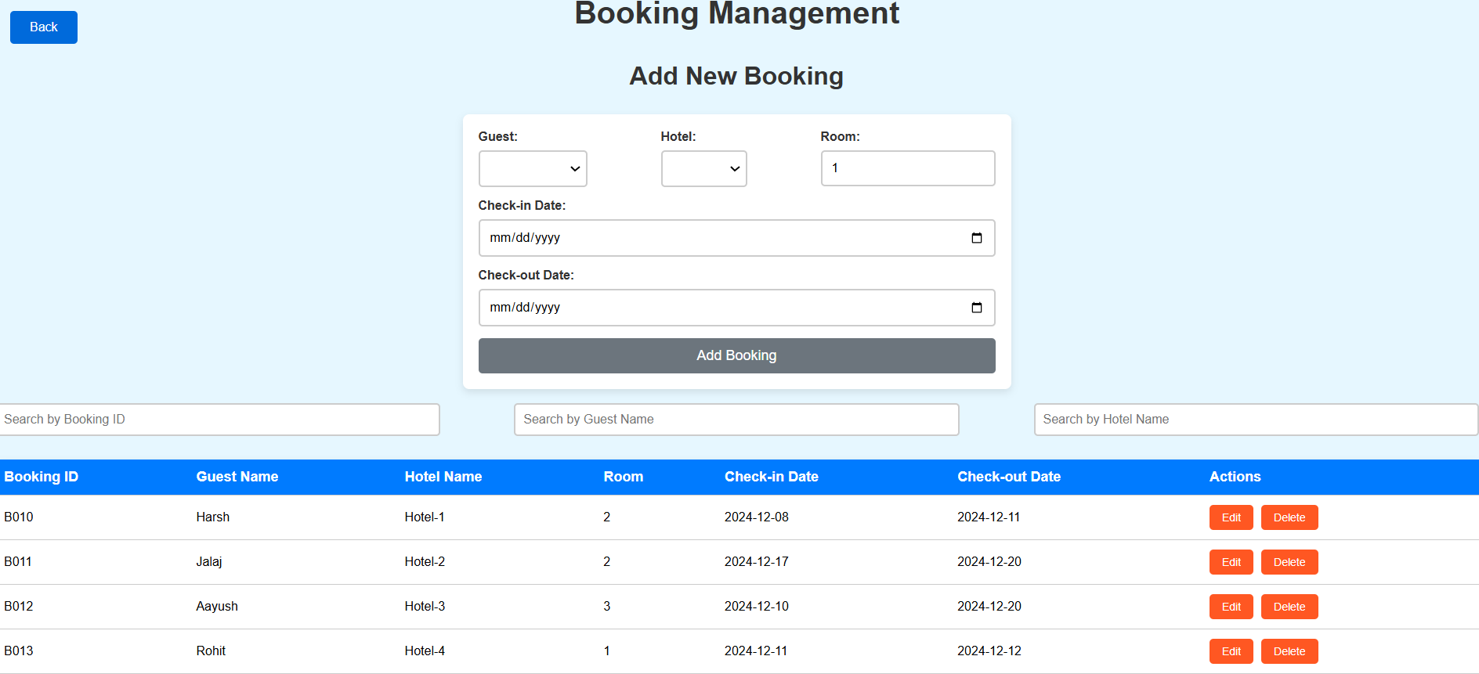
Key Features and Functionality – BOOKINGS DASBOARD

Slide 18
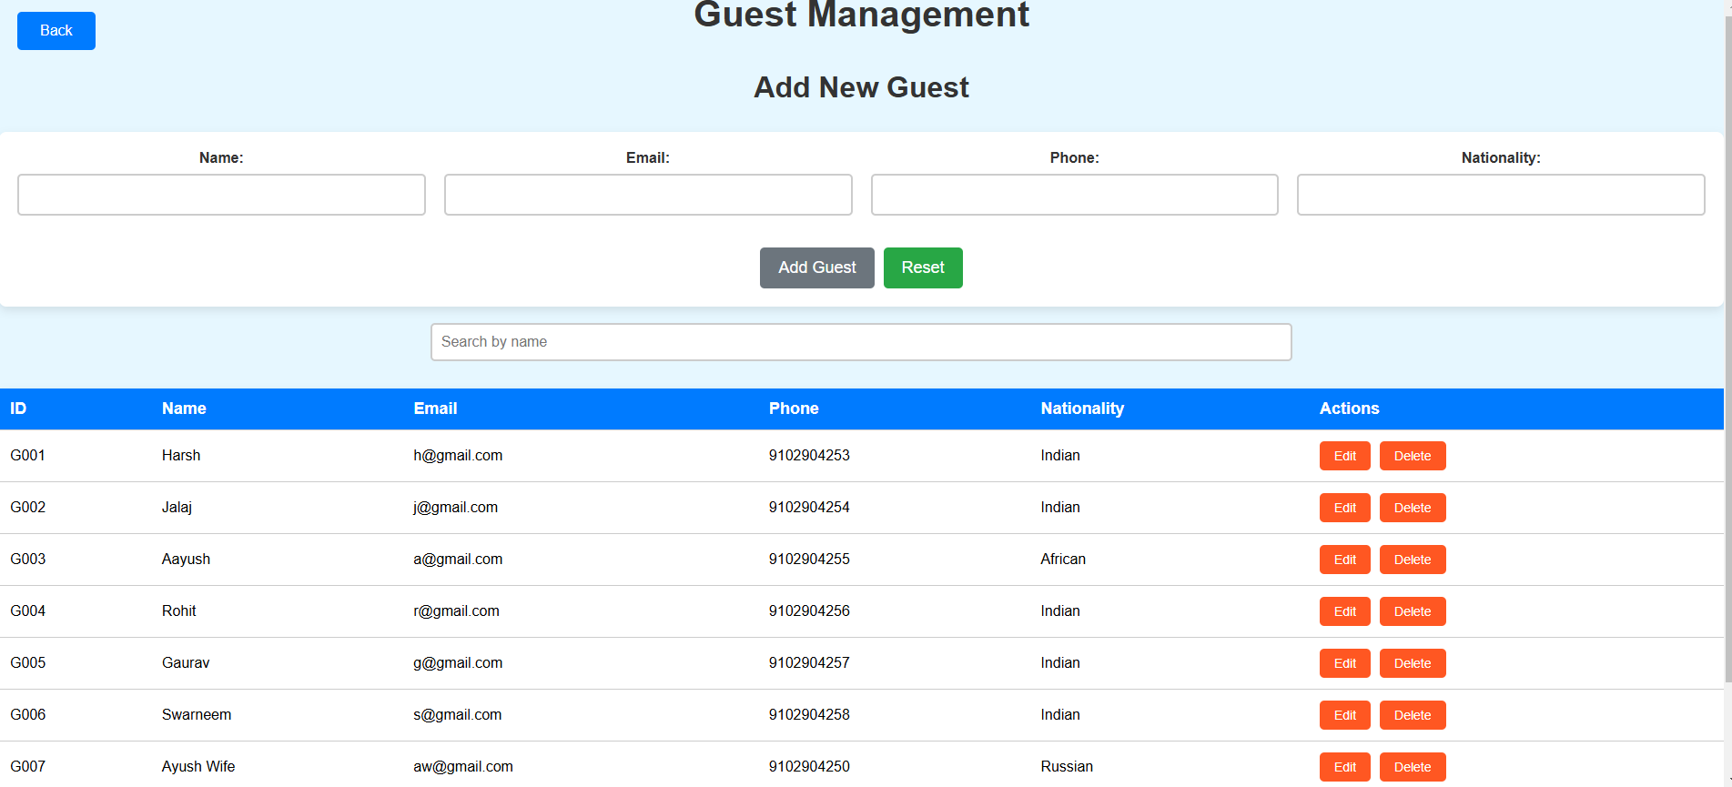
Key Features and Functionality – guest dashboard

Slide 19
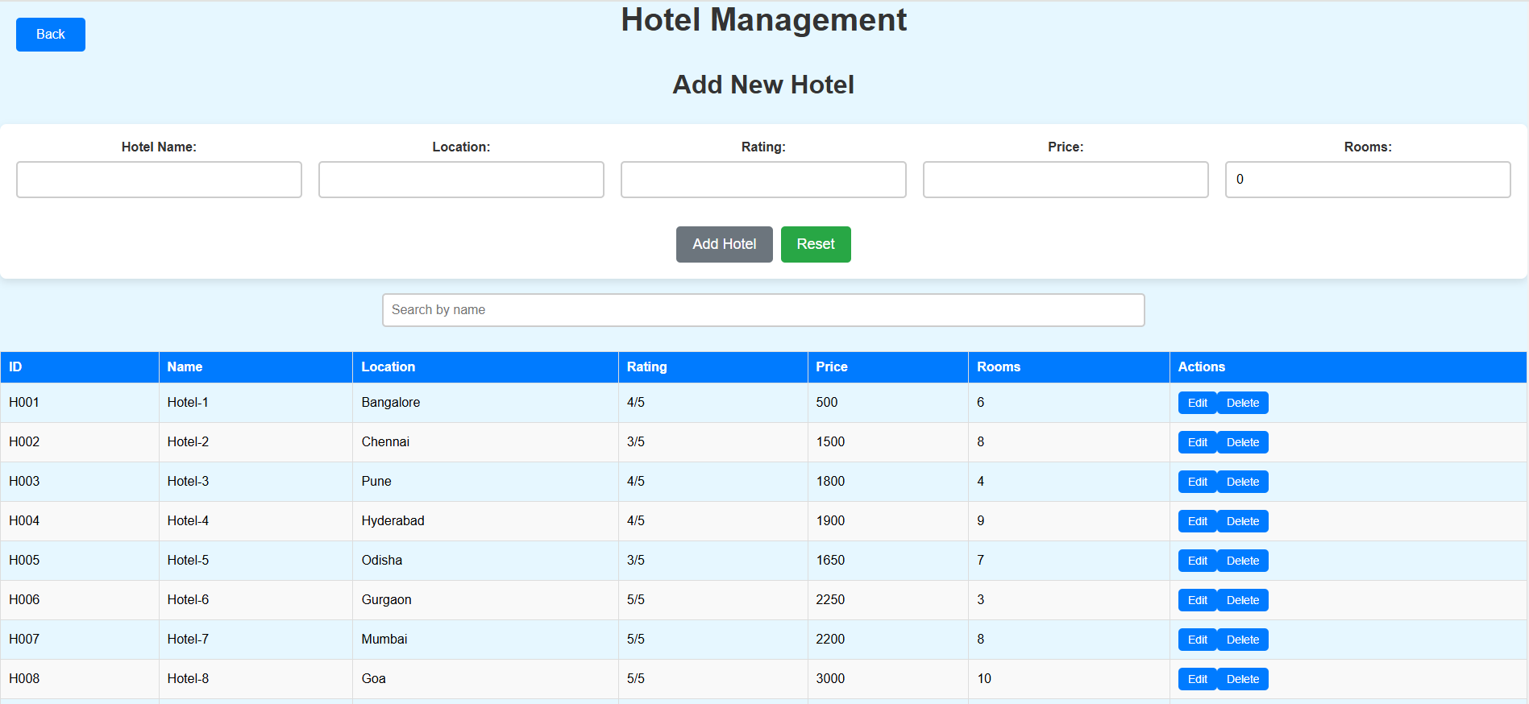
Key Features and Functionality – Hotels dashboard

Slide 20
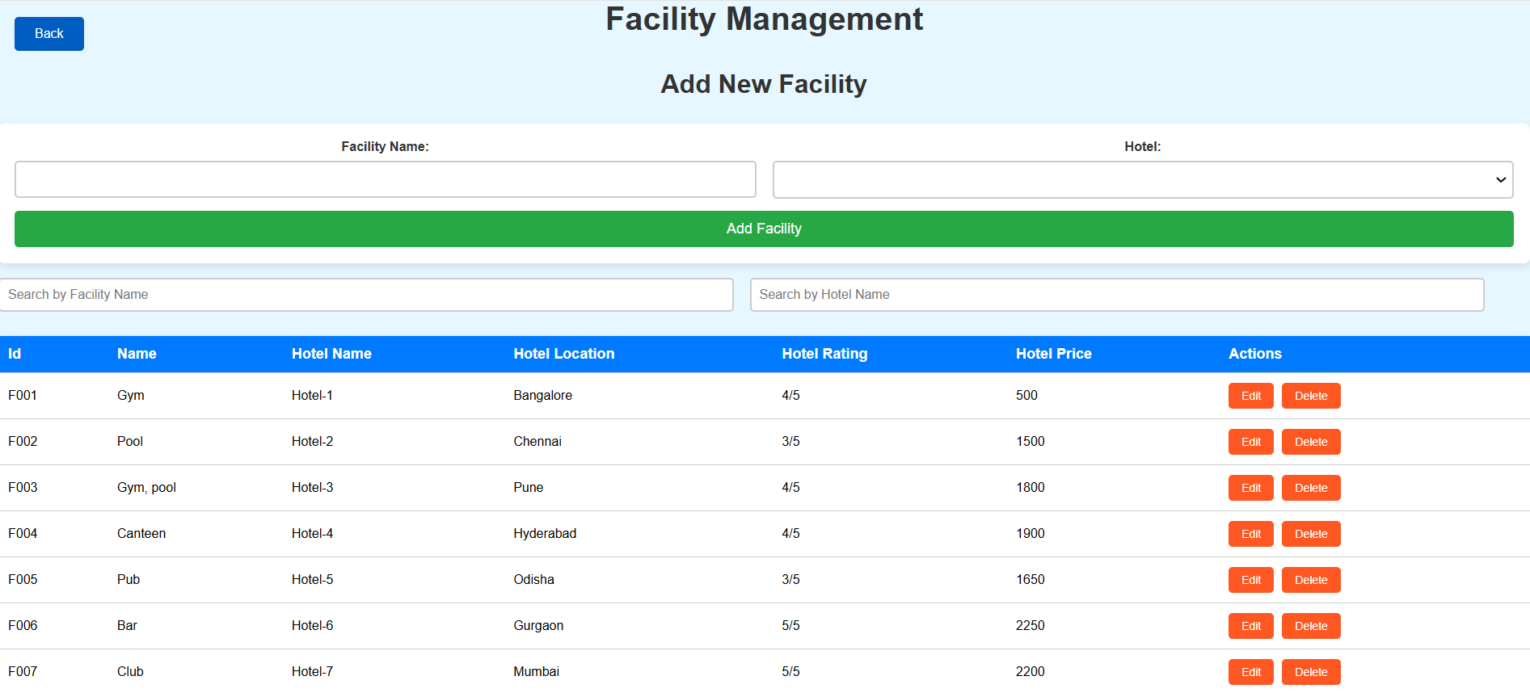
Key Features and Functionality – FACILITY DASBOARD

Slide 21
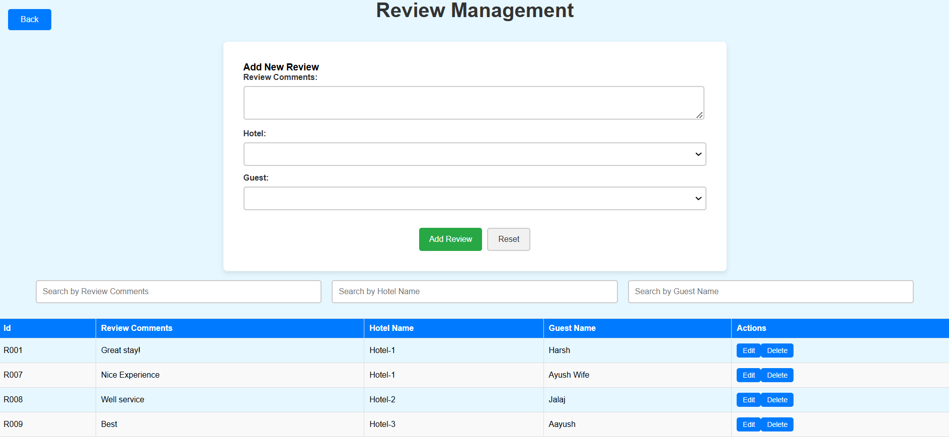
Key Features and Functionality – REVIEWS DASHBOARD

Slide 22
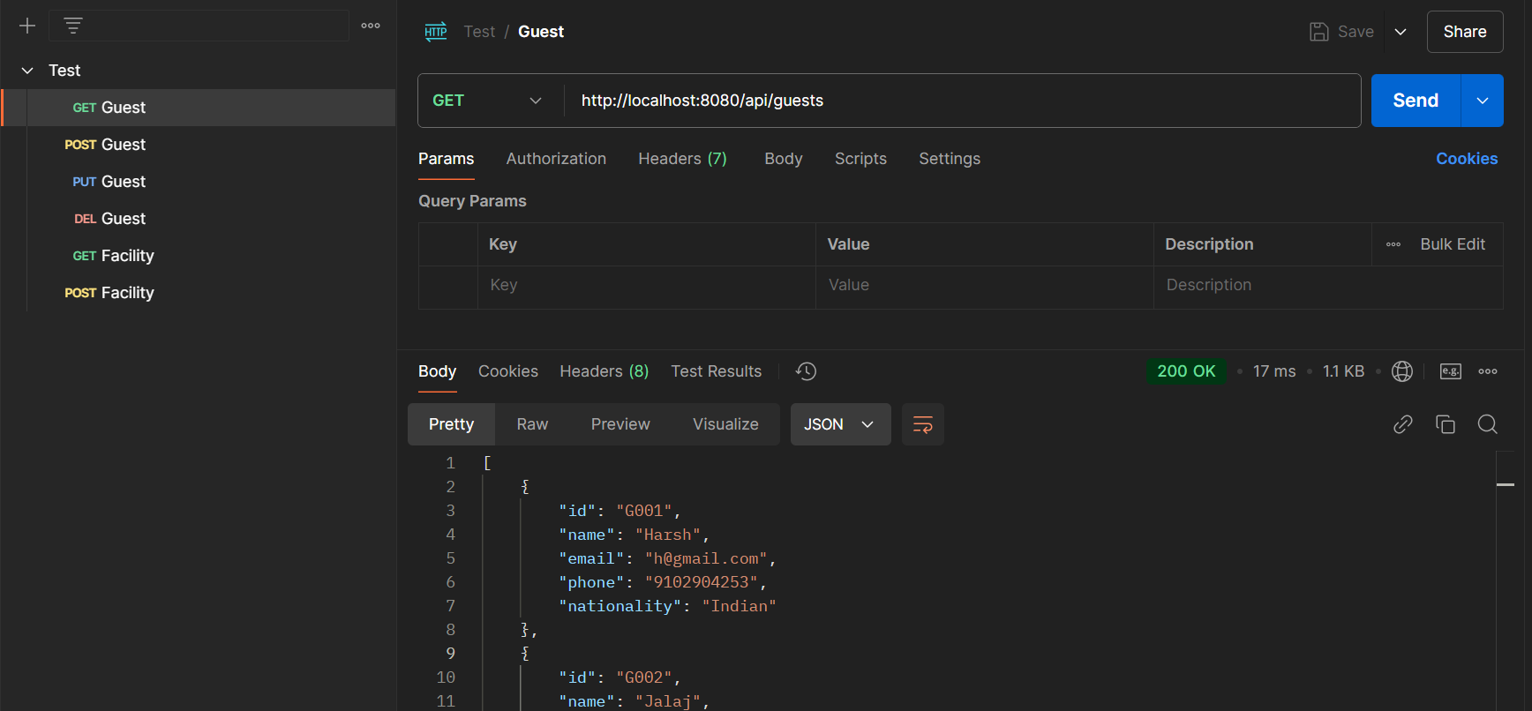
Testing and Quality Assurance API Testing with Postman (GET)

Slide 23
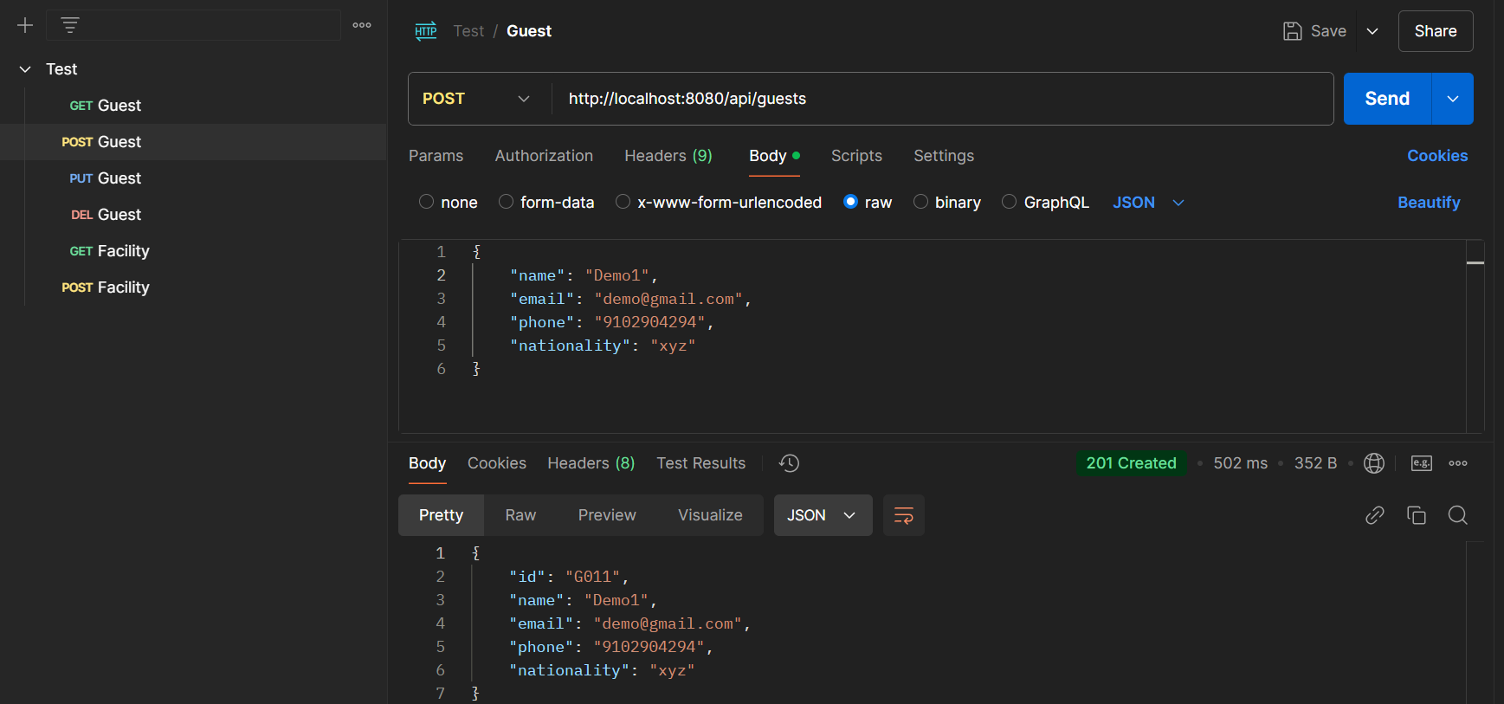
Testing and Quality Assurance API Testing with Postman (post)

Slide 24
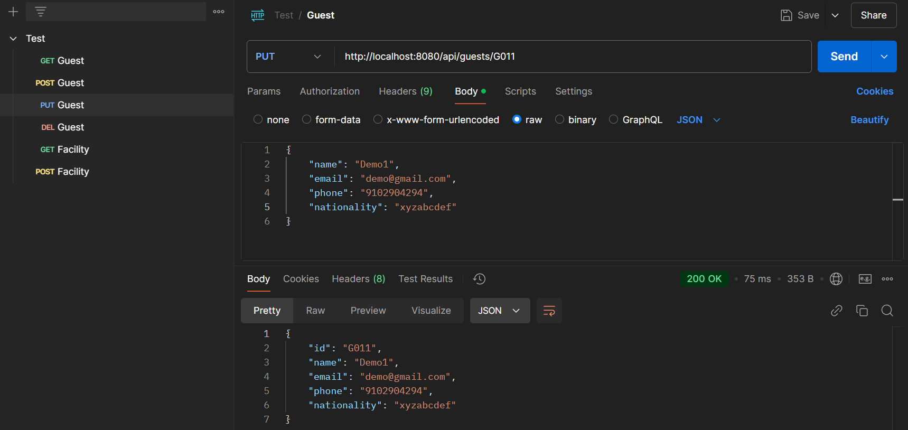
Testing and Quality Assurance API Testing with Postman (PUT)

Slide 25
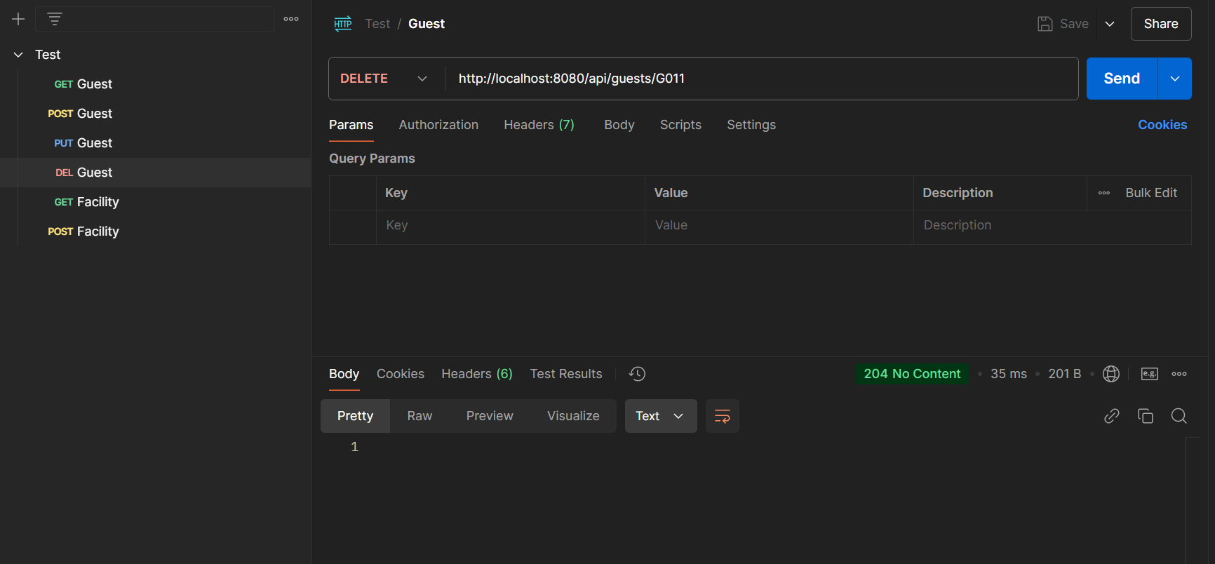
Testing and Quality Assurance API Testing with Postman(delete)

Slide 26
Challenges and Solutions
Handling Scalability Issues - Optimizing database queries and Codes of Angular and Springboot.
1
Security Challenges (Authentication and Authorization, Data Protection) - Mitigating common threats such as Routes injection.
2
Integration Challenges (Frontend and Backend) - Synchronizing data between frontend and backend, handling state management.
3

Slide 27

Conclusion
The Tour Management System features secure user authentication and authorization, a comprehensive admin dashboard, and streamlined tour management. It enables seamless frontend-backend interaction, efficient MySQL database integration, and rigorous API testing with Postman. The system is designed for scalability, ensuring high performance and security for admins.

Slide 28

Future Enhancements
Adding new features like payment gateway integration
Multi-language support
Enhanced analytics.
Load balancing
Database Optimization for Performance

Slide 29

Appendix - References
Training materials by Subbu Sir - https://github.com/ASCBLR04OCT2024GITHUUB/ASCBLR04OCT2024GIT
Java Docs - https://docs.oracle.com/en/java/
Angular docs - https://angular.dev/
Springboot docs - https://docs.spring.io/spring-boot/index.html

Slide 30

Thank you !!

